Slide 1
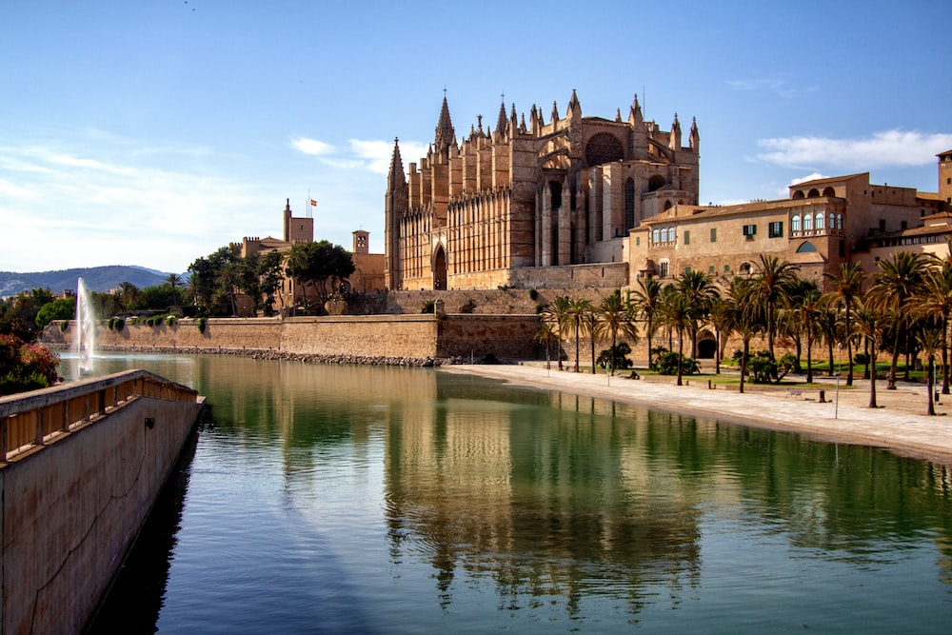
MALLORCA

Slide 2
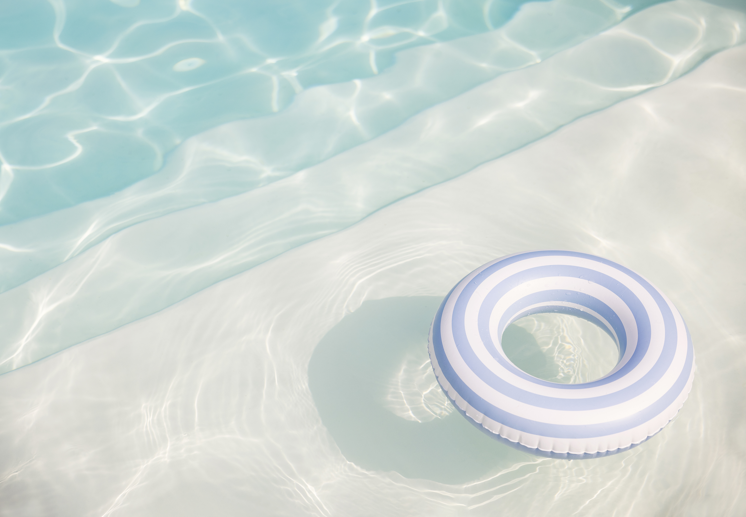
Overview
Nestled in the Mediterranean, Mallorca is an enchanting island that beckons travelers from around the world.
It is one of the four Balearic Islands, belonging to the beautiful country of Spain.
With its diverse landscapes, Mallorca is a destination where nature's artistry shines, featuring pristine beaches, lush greenery, and rugged mountains.
The island's cultural tapestry is equally captivating, boasting a blend of Spanish, Moorish, and Roman influences that have left their mark on architecture, cuisine, and traditions.
Mallorca is blessed with a Mediterranean climate, ensuring pleasant weather year-round and making it an inviting destination for outdoor enthusiasts and sunseekers alike.

Slide 3
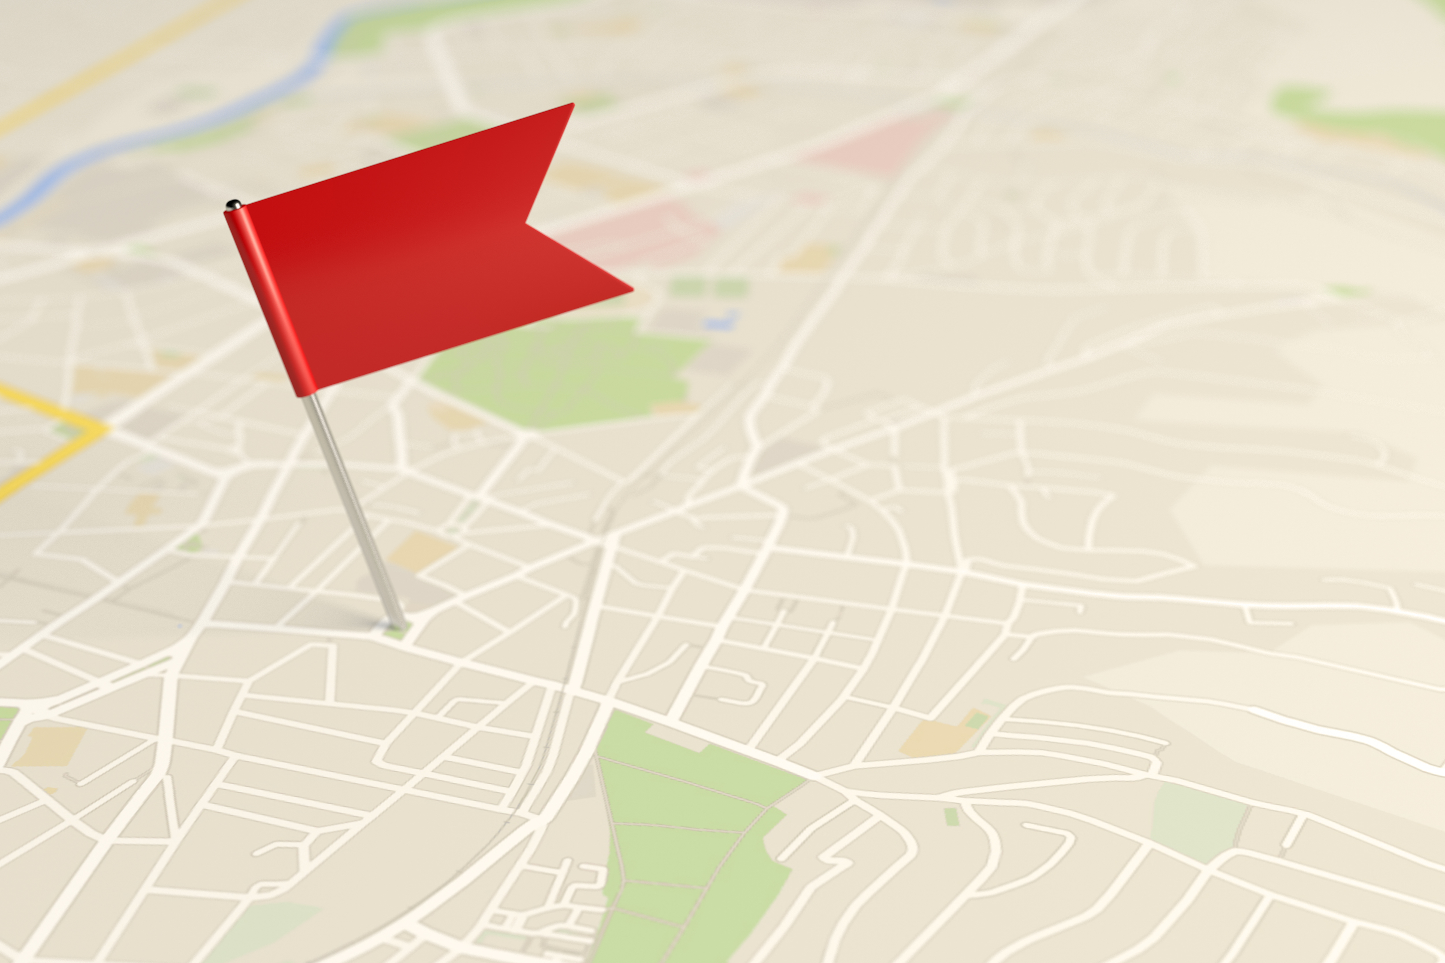
Where Is Mallorca?
Mallorca is strategically located in the heart of the Mediterranean Sea.
It is part of Spain's Balearic Islands, which also include Ibiza, Menorca, and Formentera.
Positioned to the east of the Iberian Peninsula, Mallorca enjoys close proximity to mainland Spain.
The island's strategic location has historically made it a crossroads of cultures and civilizations.
Mallorca is easily accessible by air, with its international airport serving as a major gateway for travelers from Europe and beyond.

Slide 4
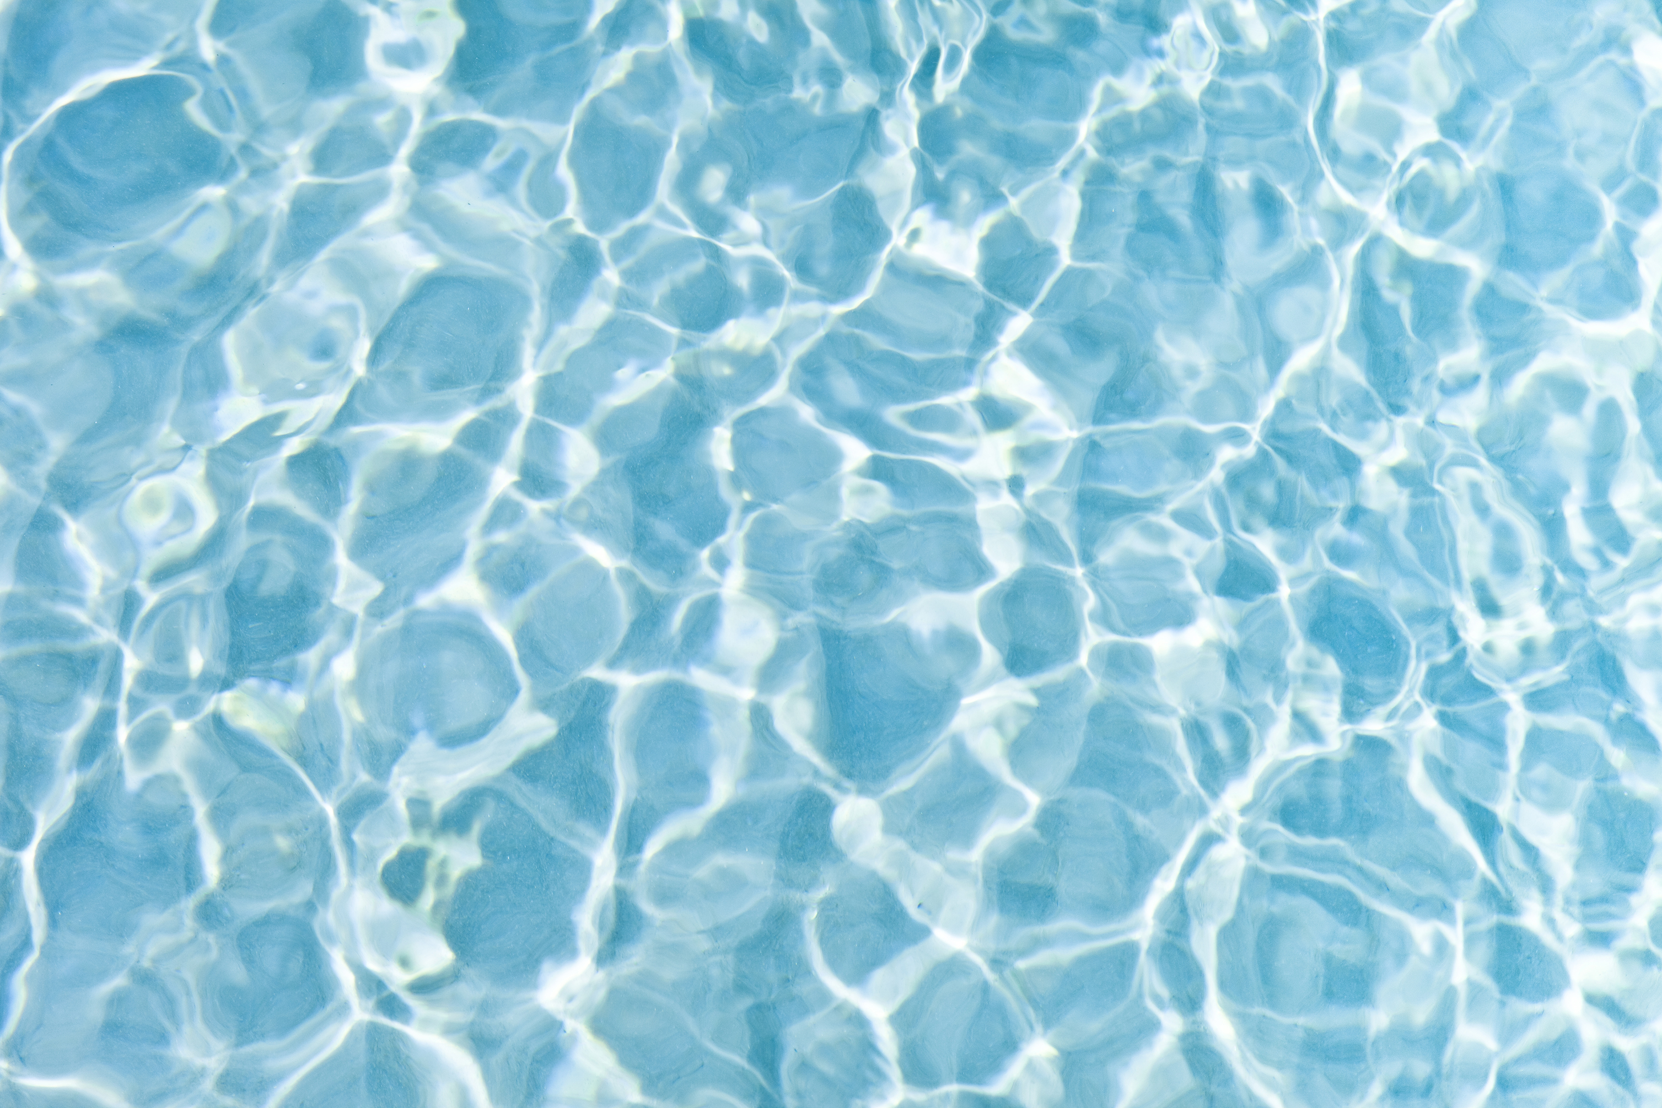
Year Round Sunshine!
Mallorca boasts a Mediterranean climate, characterized by mild, inviting winters and warm, sun-soaked summers.
With over 300 days of sunshine annually, Mallorca is a year-round destination for those seeking pleasant weather.
Winters are mild, making it an excellent escape from colder climates, with temperatures rarely dipping into uncomfortable lows.
Summers are characterized by long, sunny days, perfect for beachgoers and outdoor activities.
The island's climate is a major draw, offering travelers the opportunity to explore and relax in comfortable conditions throughout the year.

Slide 5
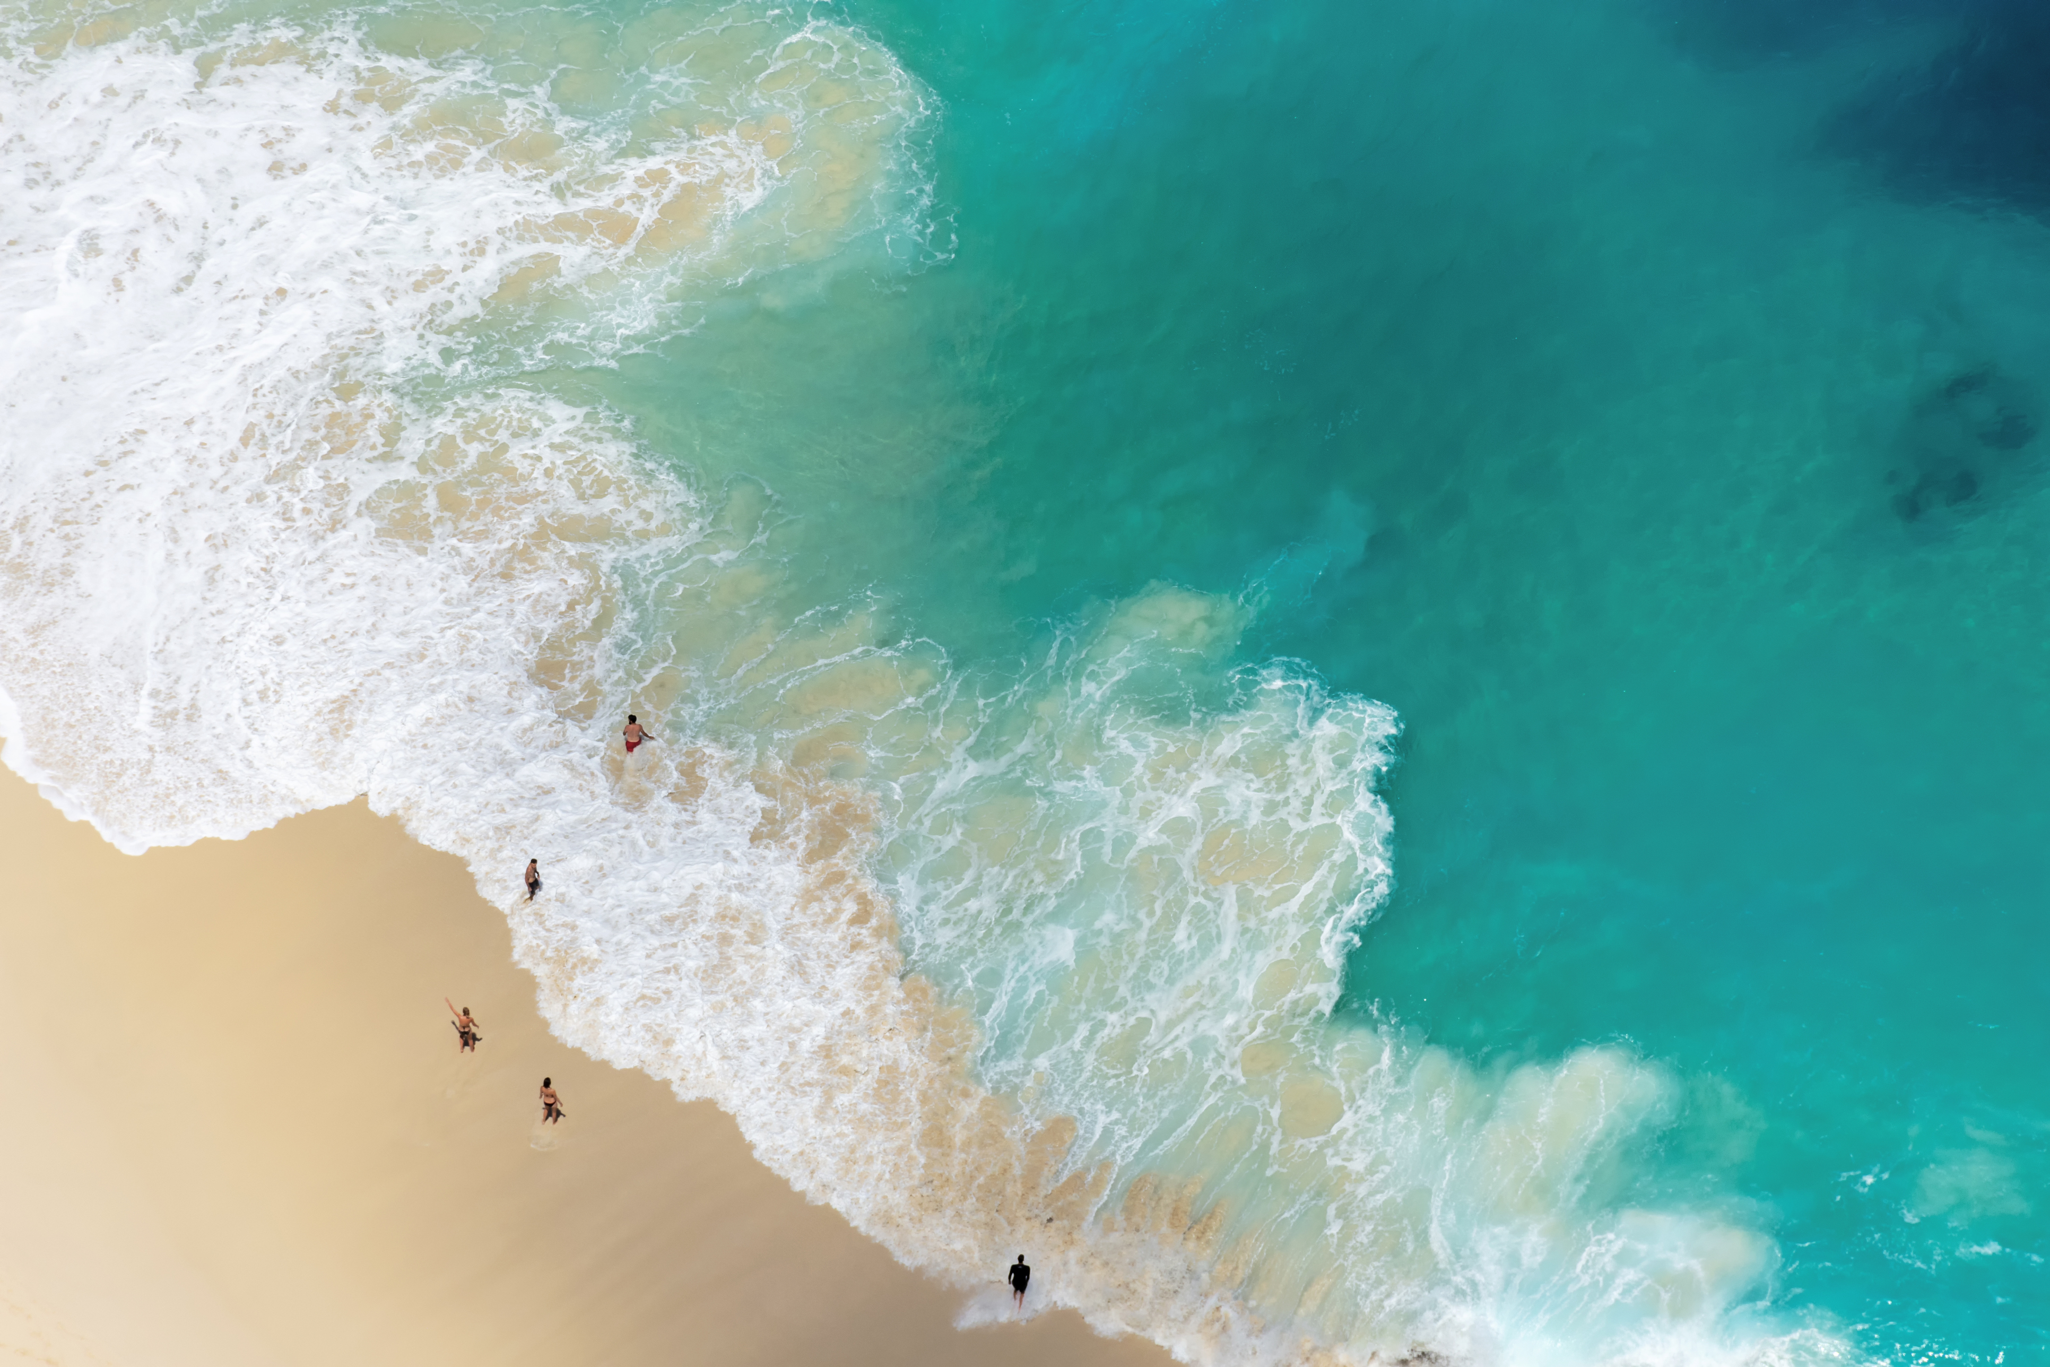
Pristine Beaches
Mallorca is renowned for its breathtaking beaches, each with its unique charm and character.
Cala Mondrago, nestled within a natural park, offers serene, turquoise waters and pristine white sands, making it perfect for relaxation and swimming.
Es Trenc, a paradise of untouched beauty, stretches for miles with powdery sand and clear waters, attracting nature lovers and sun-seekers.
Cala Agulla, surrounded by pine forests and dunes, provides a more secluded beach experience with crystal-clear waters and water sports opportunities.
With a variety of beaches to explore, Mallorca offers visitors the chance to discover their own slice of coastal paradise.

Slide 6

Rich culture
Mallorca's history is a tapestry woven with influences from various civilizations, including the Romans, Moors, and Spaniards.
The capital city, Palma de Mallorca, is home to architectural gems like La Seu Cathedral, a stunning Gothic masterpiece, and Bellver Castle, a circular fortress with panoramic views.
Throughout the island, you'll encounter charming villages with cobbled streets, traditional markets, and historic buildings that showcase its cultural heritage.

Slide 7
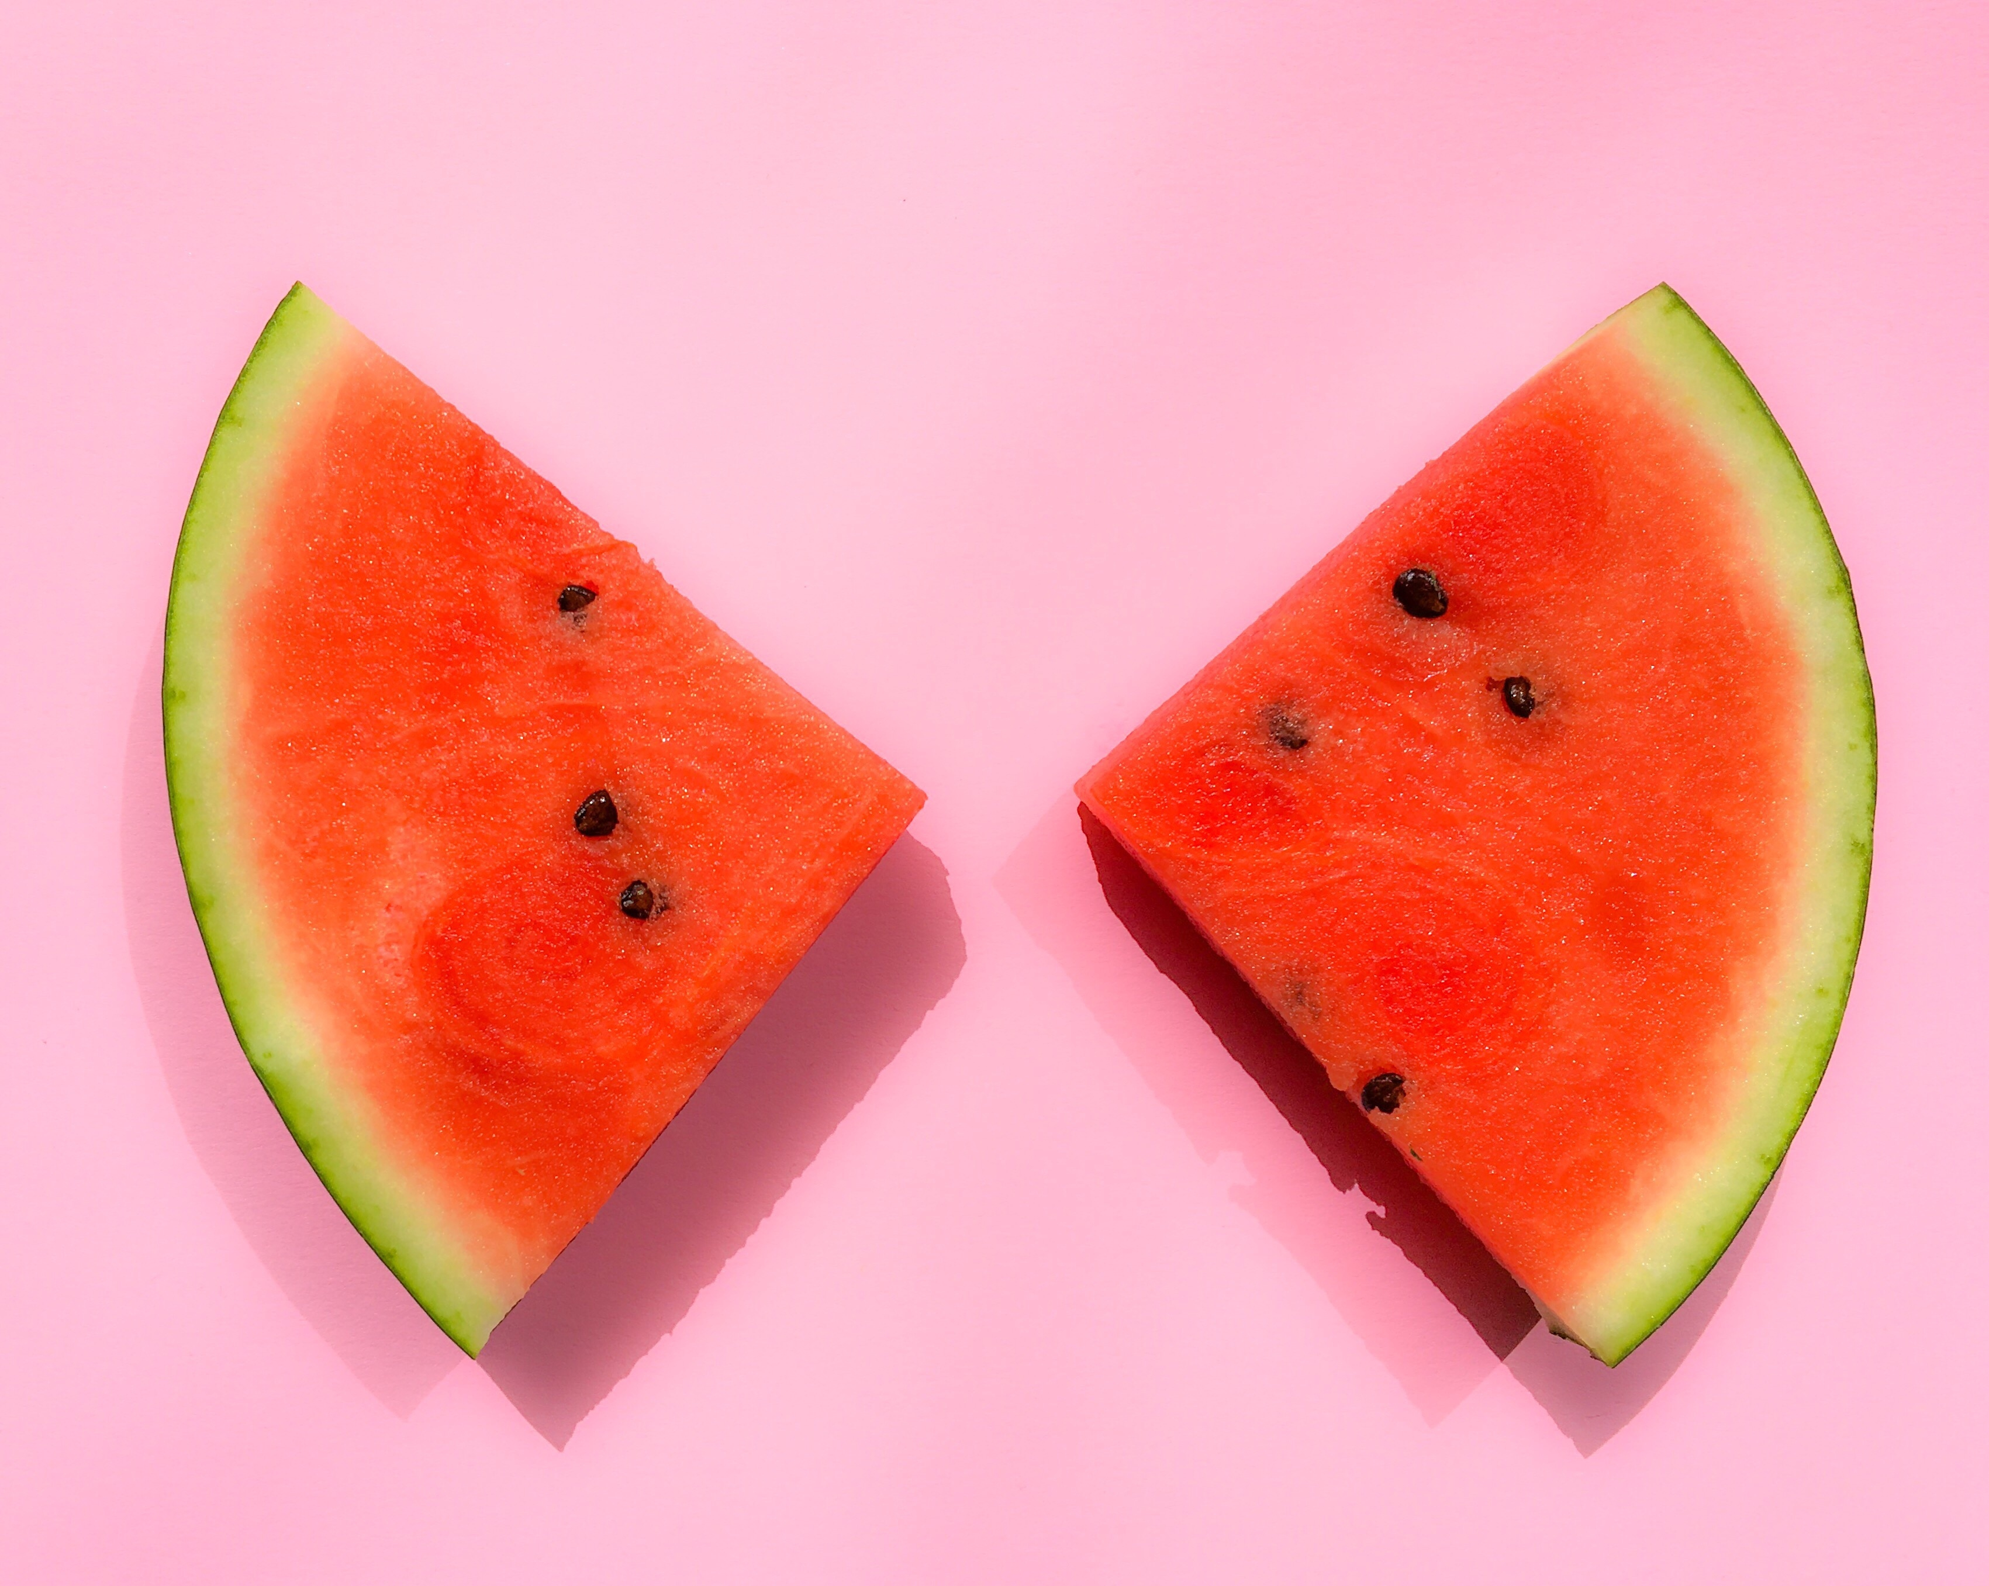
Local Cuisine
Mallorcan cuisine is a delightful fusion of Mediterranean flavors and local ingredients.
Must-try dishes include "paella," a flavorful rice dish often featuring seafood, and "sobrasada," a spicy cured sausage native to the island.
Don't miss "ensaimada," a sweet pastry that's perfect for breakfast or dessert, typically dusted with powdered sugar.
Fresh seafood, such as "gambas a la plancha" (grilled prawns) and "calamari a la romana" (fried squid), are abundant and delicious.
Dining at local restaurants offers a culinary journey that captures the essence of Mallorca's gastronomic traditions.

Slide 8
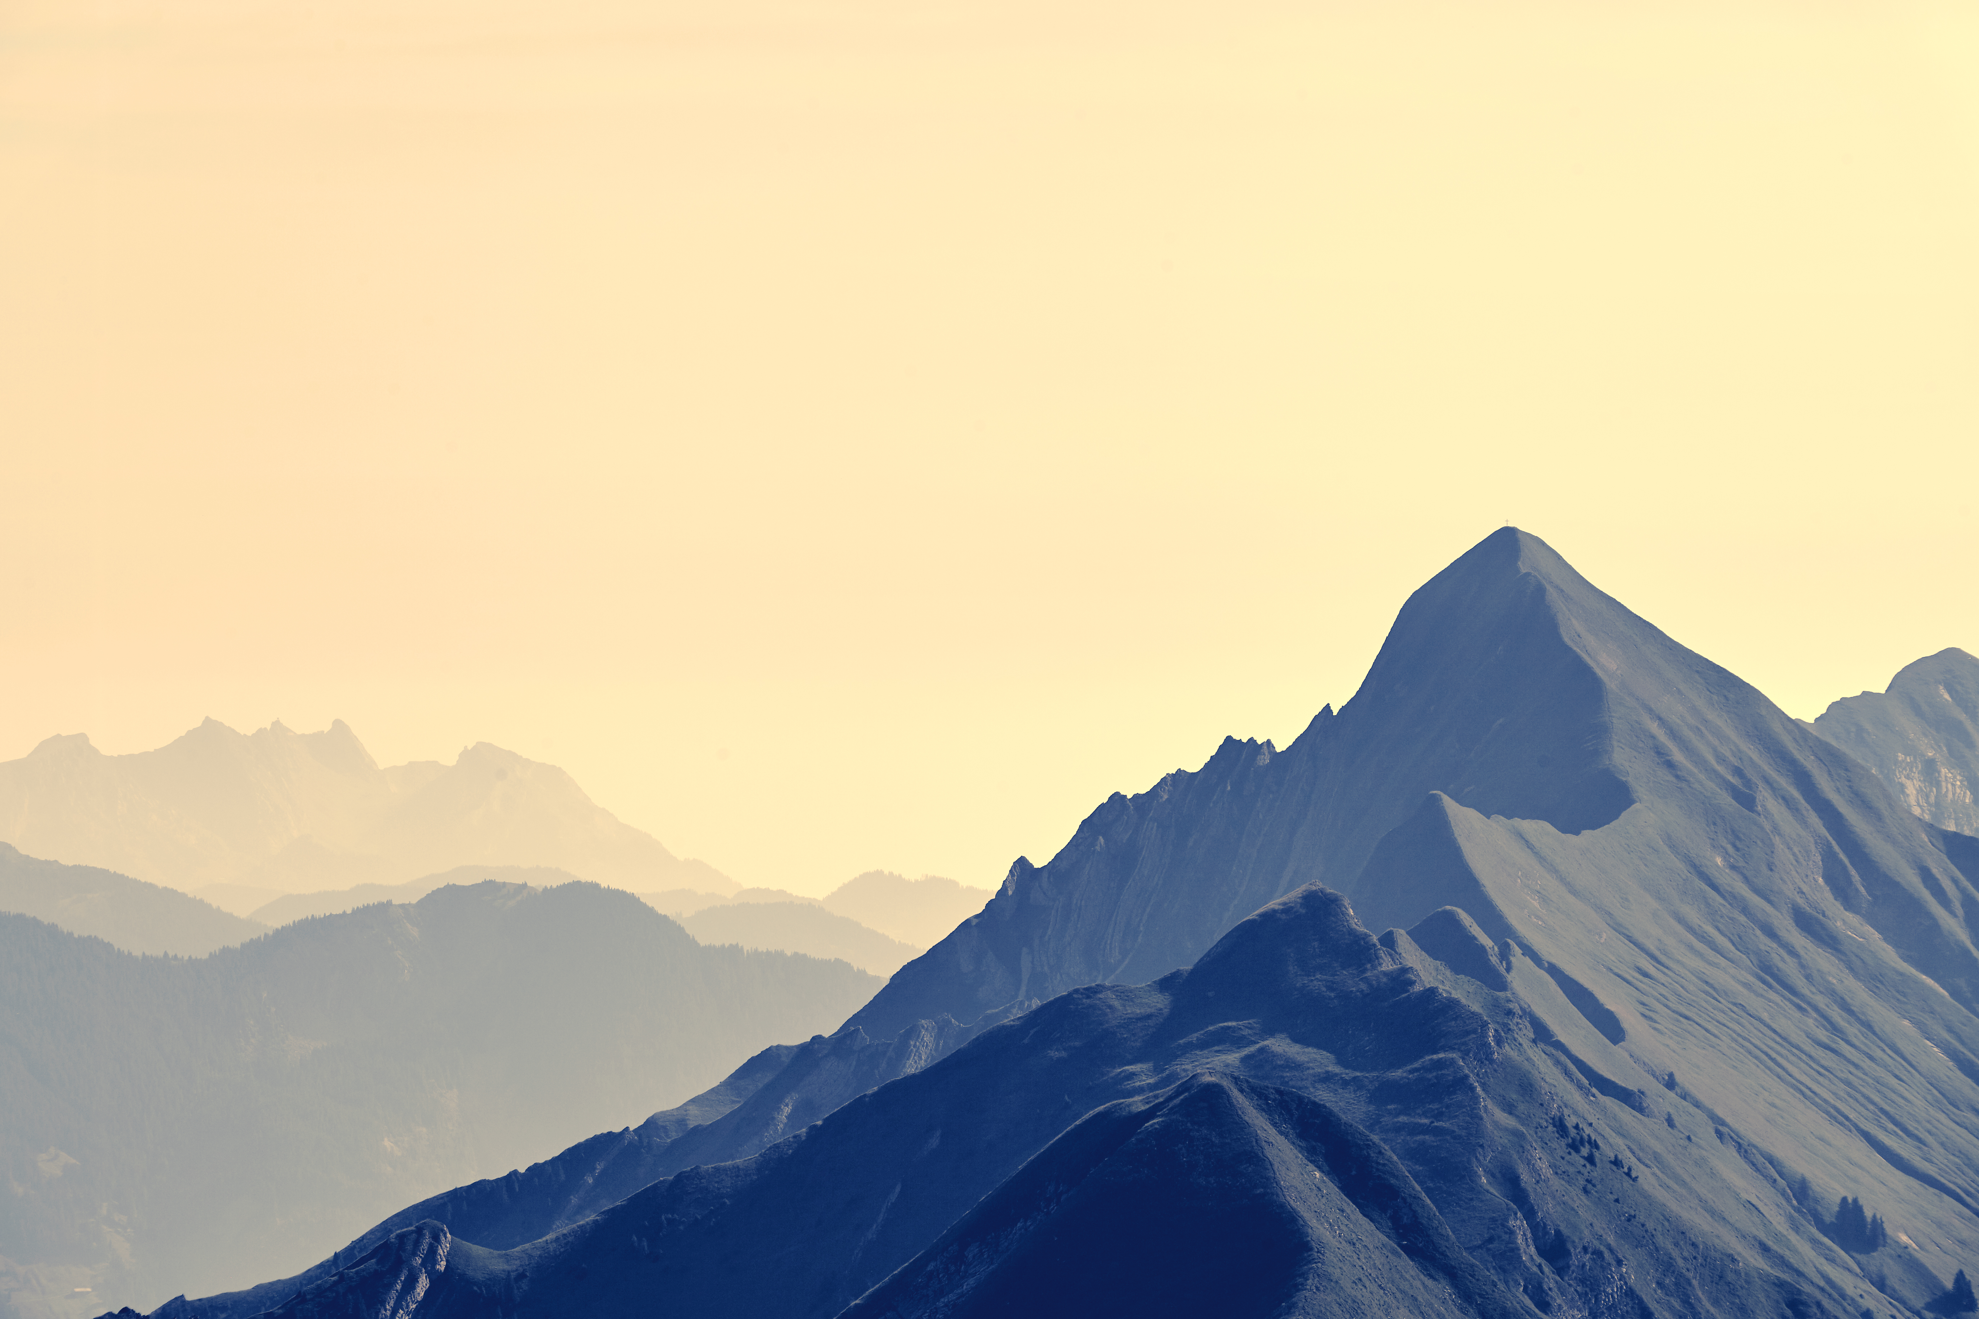
Adventures
Mallorca's diverse landscapes provide a playground for adventure seekers.
Hiking enthusiasts can explore the Tramuntana Mountains, a UNESCO World Heritage site, with picturesque trails and panoramic vistas.
Cyclists will find scenic routes along coastal roads and through charming villages, catering to all skill levels.
Water sports enthusiasts can enjoy snorkeling, diving, and sailing in the crystal-clear Mediterranean waters.
For thrill-seekers, there are opportunities for rock climbing, canyoning, and even hot air ballooning, offering an adrenaline rush against a stunning backdrop.

Slide 9

Night LIFE!!
When the sun sets, Mallorca comes alive with a vibrant nightlife scene.
Palma, the island's capital, offers a multitude of bars, clubs, and lounges, ensuring a memorable night out.
Live music venues feature a diverse range of genres, from traditional Spanish flamenco to contemporary pop and rock.
Beach clubs and waterfront bars create a unique atmosphere where you can sip cocktails while enjoying ocean views.
The nightlife options in Mallorca cater to different tastes, from those seeking a relaxed evening to those looking to dance the night away.

Slide 10
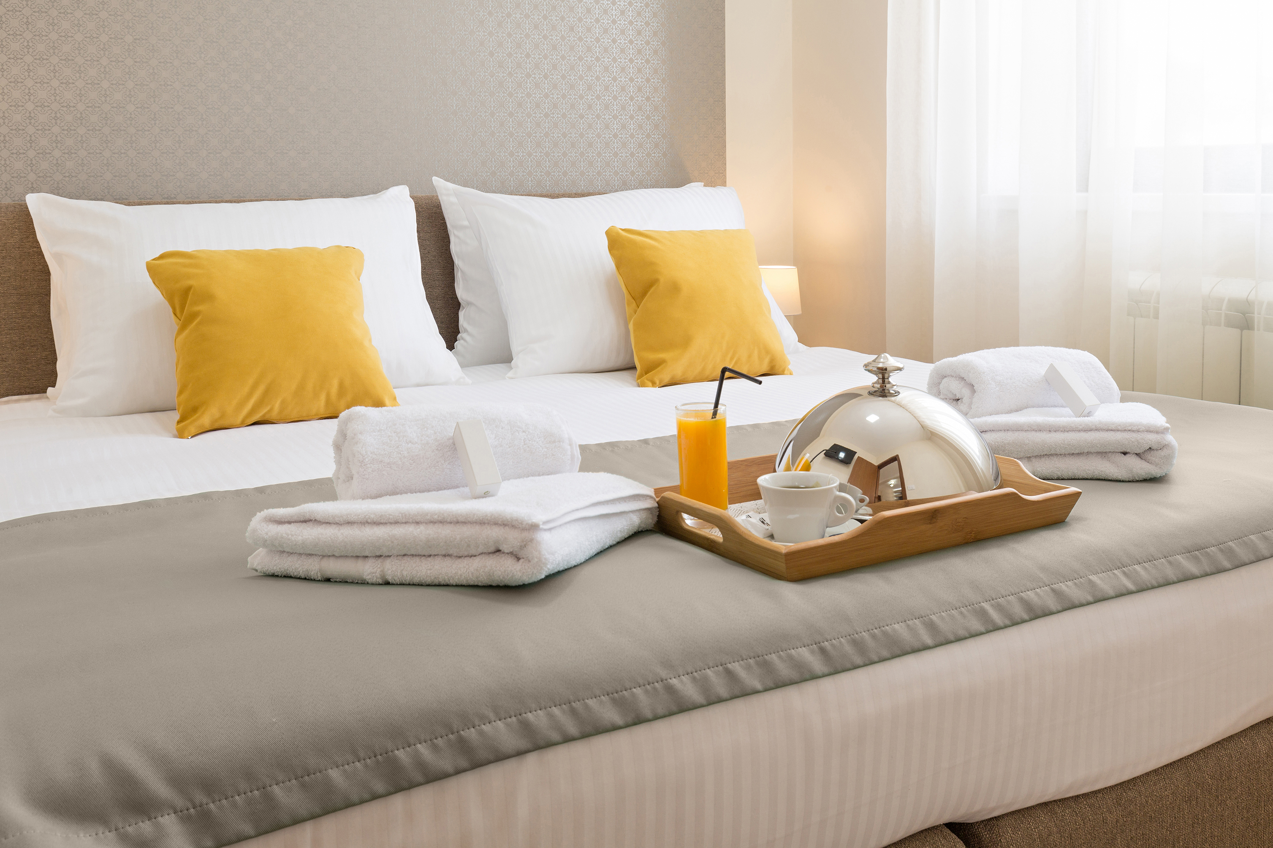
Accommodation
Mallorca offers a wide range of accommodation options to suit every traveler's preferences and budget.
Luxury-seekers can indulge in upscale resorts and boutique hotels, many of which boast stunning sea views and world-class amenities.
For those looking for a more budget-friendly stay, there are plenty of comfortable hostels, guesthouses, and vacation rentals available.
Charming rural accommodations and agroturismos offer a unique and authentic experience in the Mallorcan countryside.
Whether you prefer beachfront villas, historic city-center hotels, or rustic retreats, Mallorca has diverse choices to ensure a comfortable and memorable stay.

Slide 11

COME ALONG!
Start by choosing the best time to visit Mallorca, considering your preferred weather and activities.
Mallorca's international airport in Palma de Mallorca ensures convenient access from major European cities.
Consider renting a car or using public transportation to explore the island's diverse regions.
Visit the official tourism website or local visitor centers for information on attractions, tours, and cultural events.
Don't forget to check for any special festivals or events happening during your stay to immerse yourself in Mallorca's vibrant culture.

